Slide 1
Making Moves in the Continental U.S
Clustering Neighborhoods for an Informed Move

Slide 2
The problem:
Existing tools that show city demographics and break down often focus city wide
Data Sources exist in silo
Many sources of data on things such as income, education, property value are isolated from sources like Foursquare that give an idea of area ‘walkability’ and access to venues
Desirable areas are relative to the user
Access to parks and doctors would be more valuable for families
Access to coffee shops, restaurants and night life may be more desired for young professionals
Comparison of the neighborhoods within cities would allow a user to find a similar area to move to, or make an informed change

Slide 3
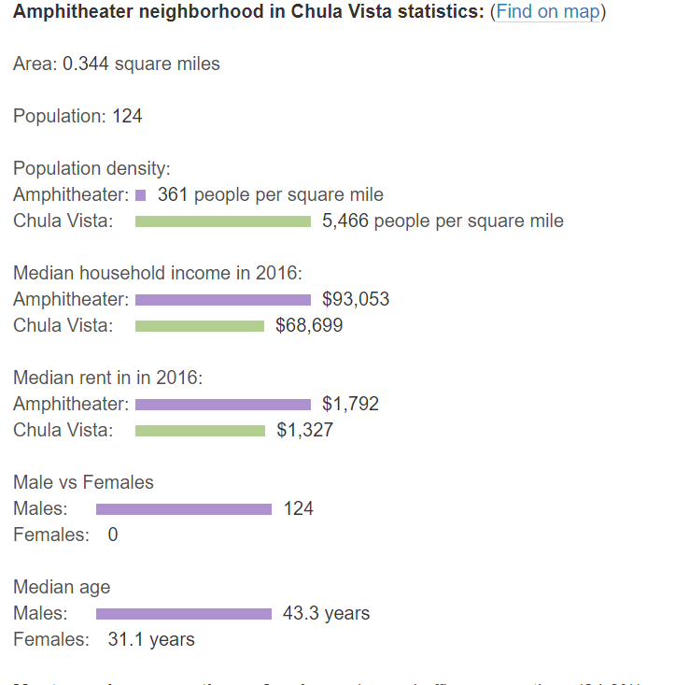
Data Acquisition
Neighborhood pairing to zip code from City-Data.com
Web scraping desired features via Beautiful Soup
Population Density, Median Household Income, etc
Latitude and Longitude
Obtained via Geocoding GeoPy
Venue proximity from Foursquare API
Searching within 100 meters of each latitude and longitude set
Value revised to 500 meters to obtain more results

Slide 4
Data Transformation and cleaning
Import and strip html elements from City-Data.com. Loops are used to store neighborhood data in lists
Zip lists into a Pandas Data frame
Add columns for latitude and longitude to data frame
Label numerical characteristics as ‘High’, ’Medium’, ’Low’
Perform one hot encoding to translate categorical variables to binary numerals
Group neighborhoods together

Slide 5
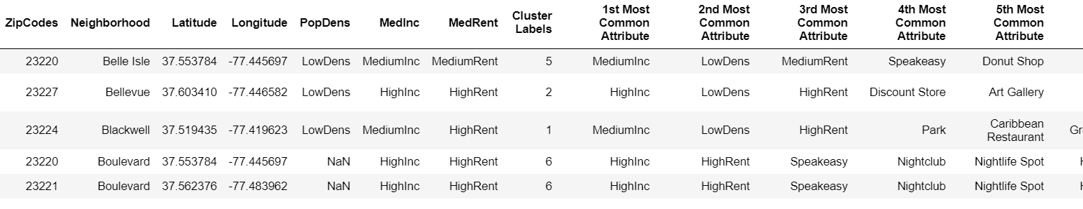
Clustering
After one hot encoding, group rows by their neighborhood and take the mean of the frequency of occurrence of each category
Morph the data to display the top 10 most common venues in each neighborhood
Using Kmeans from sklearn, trail k values of 12, 15, 8
Observe that clustering seems highly dependent on the 1st and 2nd Most common attributes
Including features from City-Data with the Foursquare venues data create far more representative clusters.
Using a city where attributes of neighborhoods are known, Richmond VA allow evaluation as to the appropriateness of the clusters.

Slide 6
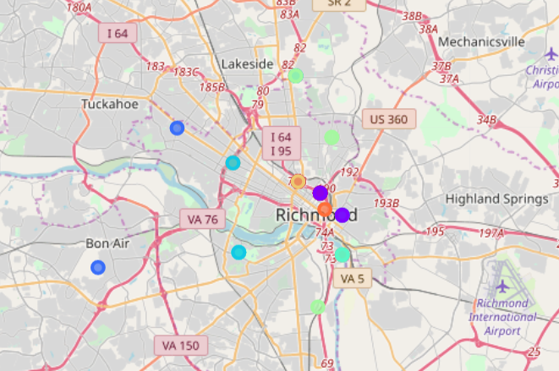
City 1- Richmond, VA

Slide 7
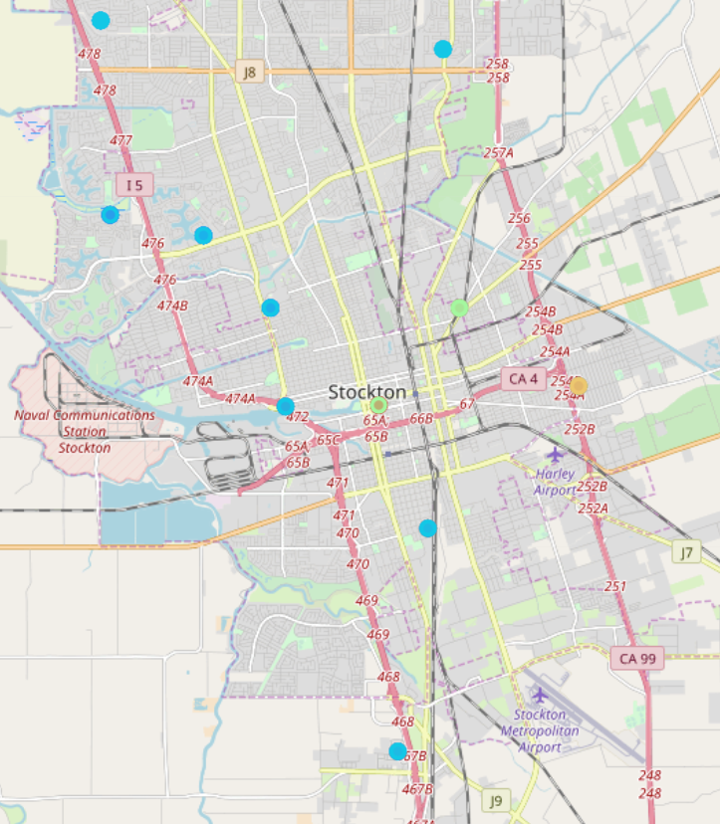
City 2- Stockton, CA

Slide 8
Conclusions
The value of 8 for k creates the most appropriate clusters for the two cities in this test case, Richmond, VA and Stockton, CA.
Cluster 1 in city 2 compared to cluster 2 in city 1 both show neighborhoods with High Median Incomes, Low Population Density and High Median Rents. Knowledge of the first city affirms that that City 1 Cluster 2 represents affluent suburbs, desirable for families and those seeking to invest in owning their own home.
Likewise, Cluster 5 in City 1 and Cluster 2 in City 2 share many attributes pointing to middle income, residential areas. Both clusters have Medium Income, Medium Rent and Medium Population Density, with restaurants and services catering to residents (banks and gyms).

Slide 9
Future Paths
Include Housing Prices/Value to inform users looking to purchase real estate
Data from City-Data is sparse on this,
Perhaps scrape public tax information for property values
Create a user interface that abstracts the code:
Doesn’t require a Foursquare Developer Account
Doesn’t require any python experience
Allows a user to input any two target cities
Allows users to have input on what features are important. Access to venues? Or areas in a certain price band?

